Slide 1
Course Code:CSC402A Course Title: Web Architecture and Application Development
Course Leader:
Kishore S.M.
kishore.cs.et@msruas.ac.in

Slide 2
Objectives
After completing this lecture, the student will be able to
Analyze asynchronous communication architecture
Describe Buffered Message-Based Software Architecture
Analyze Point-to-Point Messaging (P2P)
Analyze Publish-Subscribe Messaging (P&S)

Slide 3
Contents
Buffered Message-Based Software Architecture
Point-to-Point Messaging (P2P)
Publish-Subscribe Messaging (P&S)

Slide 4
Asynchronous Communication Architectures
Asynchronous Communication Software Architecture
An asynchronous implicit invocation communication can be specified in two different modes: nonbuffered and buffered.
Regardless of the type of asynchronous architecture, the main purpose of this type of communication architecture is to provide a decoupling between the event/message, the publishers/producers, and the subscribers/customers.

Slide 5
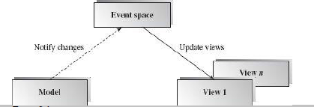
Asynchronous Communication Architectures
Nonbuffered Event-Based Implicit Invocations
The nonbuffered event-based implicit invocation architecture breaks the software system into two partitions: eventsources and event listeners
The event registration process connects these two partitions
There is no buffer available between these two parties

Slide 6
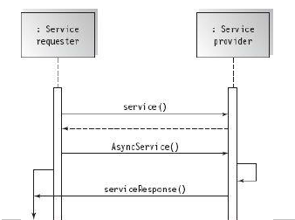
Asynchronous Communication Architectures
Synchronous vs. asynchronous invocations
The below figure depicts the explicit synchronous and implicit asynchronous connection architecture in a UML sequence diagram.

Slide 7
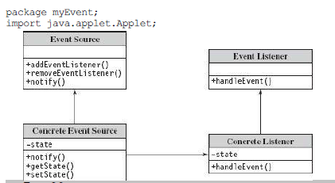
Asynchronous Communication Architectures
Class diagram for event-based implicit invocation architecture
A typical event-based implicit invocation class diagram is given in the below figure.

Slide 8
Asynchronous Communication Architectures
Benefits:
• Framework availability: Many vendor APIs such as Java AWT and Swing components are available
• Reusability of components: It is easy to plug in new event handlers without affecting the rest of the system
• System maintenance and evolution: Both event sources and targets are easy to update
• Independency and flexible connectivity: Dynamic registration and deregistration can be done dynamically at runtime
• Parallel execution of event handlings is possible

Slide 9
Asynchronous Communication Architectures
Limitations:
• It is difficult to test and debug the system since it is hard to predict and verify responses and the order of responses from the listeners. The event trigger cannot determine when a response has finished or the sequence of all responses
• There is tighter coupling between event sources and their listeners than in message queue-based or message topic-based implicit
invocation. Data sharing and data passing in the event object forwarded from event sources to event listeners also make the coupling tighter and somewhat hard to debug and test
• Reliability and overhead of indirect invocations may be an issue

Slide 10
Asynchronous Communication Architectures
Buffered Message-Based Software Architecture
The buffered message-based software architecture breaks the software system into three partitions: message producers, message consumers, and message service providers
They are connected asynchronously by either a message queue or a message topic
A sender sends out a message that requires only a guaranteed message delivery reply
Messaging-based architectures are widely used in the infrastructure for network management, telecommunication services, commerce, customer care, weather forecasting, supply chain management, banking systems, and many other systems

Slide 11
Asynchronous Communication Architectures
Point-to-Point Messaging (P2P)
A P2P messaging architecture is composed of message queues, senders, and receivers
Each message is sent to a destination (a specific queue) which is maintained by the consumer, consumer clients extract messages from these queues
The queue retains all messages it receives either until the messages are consumed or until the messages expire
Each message has only one consumer, that is, the message is “gone” once it is delivered

Slide 12
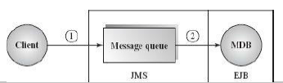
Asynchronous Communication Architectures
This approach allows multiple message receivers but only one of them will receive the message as determined by the message service provider
The Message Driven Bean (MDB) of EJB is a consumer of the message queue supported by JMS
A message producer sends a message to the message queue destination which is taken by the MDB without timing restrictions

Slide 13
Asynchronous Communication Architectures
Publish-Subscribe Messaging (P&S)
The publish-subscribe messaging architecture is a hub-like architecture where publisher clients send messages to a message topic that acts like a bulletin board
Message topic publishers and subscribers are not aware of each other
One difference between P&S and P2P is that each topic message can have multiple consumers
The system delivers the messages to all of its multiple subscribers instead of to a single receiver, as in the message queue system
Publishers and subscribers have a timing coupling dependency

Slide 14
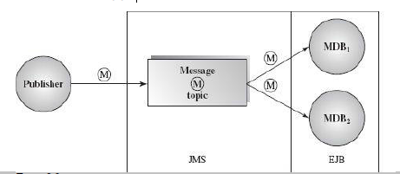
Asynchronous Communication Architectures
A message topic consumer must subscribe the topic before it is published unless the subscription is a durable subscription that is able to receive any topic messages sent while the subscribers are not active or not ready yet.

Slide 15
Asynchronous Communication Architectures
Benefits:
• Anonymity: provides high degree of anonymity between message producer and consumer. The message consumer does not know who produced the message (user independence), where the producer lives on the network (location independence), or when the message was produced (time independence)
• Concurrency: supports concurrency both among consumers and between producer and consumers
• Scalability and reliability of message delivery: Reliability mechanisms include: control level setting of message acknowledgement, message persistence setting without loss; message priority level setting; and message expiration setting

Slide 16
Asynchronous Communication Architectures
• Supports batch processing.
• Supports loose coupling between
Limitations:
• Capacity limit of message queue: This is not an inherent limitation but an implementation issue that can be minimized if the queue is implemented as a dynamic data structure (e.g., linked lists). However, there is an absolute limit based on available memory. It is also difficult to determine the numbers of agents needed to satisfy the loose couplings between agents
• Complete separation of presentation and abstraction by control in each agent generates development complexity since communication between agents only takes place between the control of agents
• Increased complexity of the system design and implementation

Slide 17
Summary
An asynchronous implicit invocation communication can be specified in two different modes: nonbuffered and buffered
A P2P messaging architecture is composed of message queues, senders, and receivers
The publish-subscribe messaging architecture is a hub-like architecture where publisher clients send messages to a message topic that acts like a bulletin board

